Slide 1
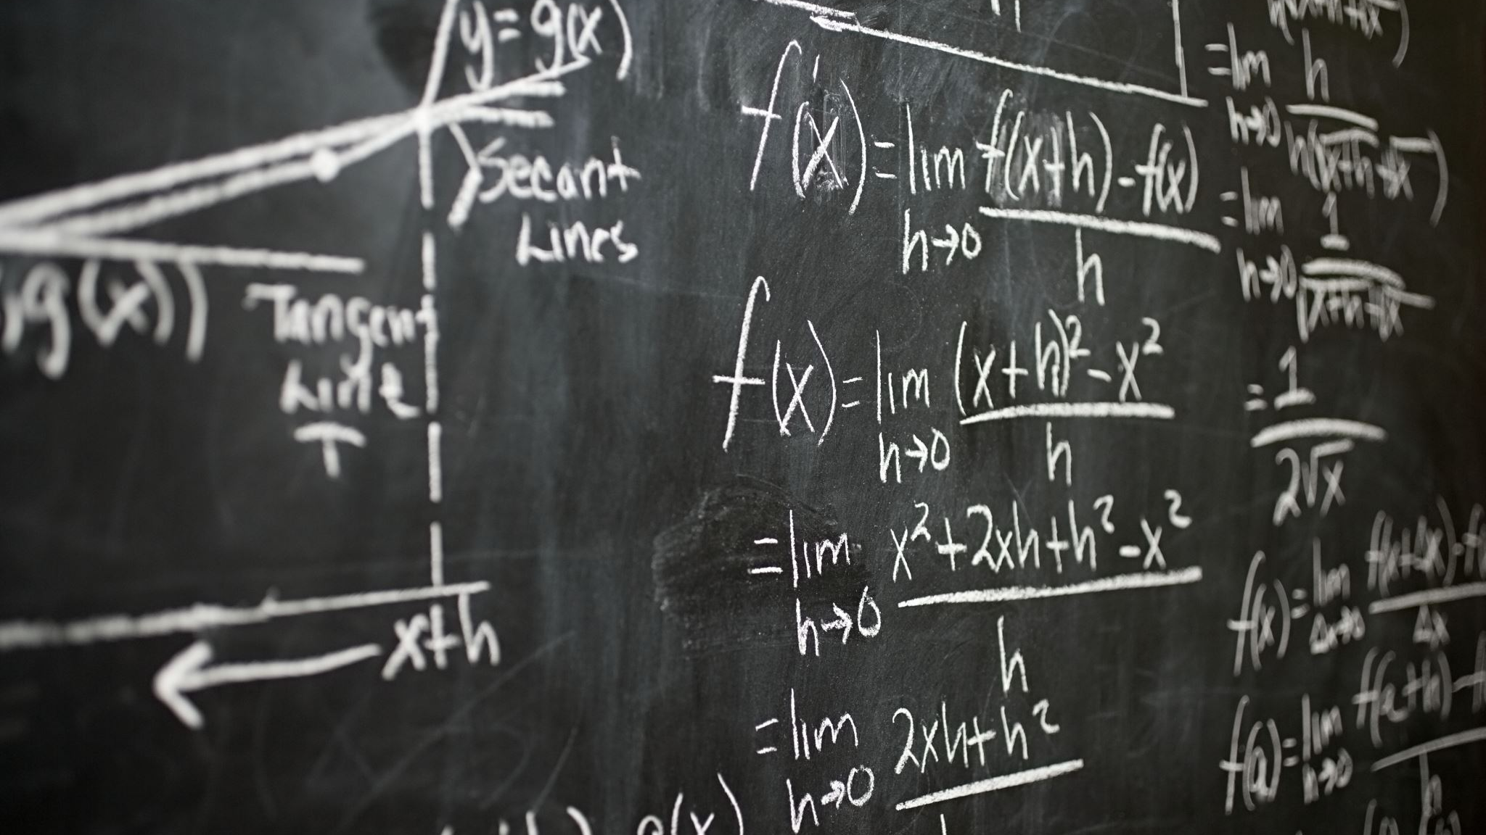
Pizarra números complejos

Slide 2
Números Complejos
$$f\left(x\right)=x^{2}+x+1=ax^{2}+bx+c$$
$$x=\frac{−b±\sqrt{b^{2}−4ac}}{2a}$$
$$x=\frac{−1±\sqrt{1^{2}−4(1)(1)}}{2(1)}=\frac{−1±\sqrt{1−4}}{2}=\frac{−1±\sqrt{−3}}{2}$$
$$x=−\frac{1}{2}±\frac{\sqrt{−3}}{2}=−\frac{1}{2}±\frac{\sqrt{(3)(−1})}{2}=−\frac{1}{2}±\frac{\sqrt{3}\sqrt{−1}}{2}$$
$$x=−\frac{1}{2}±\frac{\sqrt{3}}{2}i$$
$$i$$
Unidad imaginaria
Número Complejo
Parte Real
Parte imaginaria

Slide 3
Números
$$Números Complejos(Z)$$
$$Números Reales(R) Números Imaginarios(I)$$
$$\sqrt{−1}=i$$
$${\left(\sqrt{−1}\right)}^{2}={\left(i\right)}^{2}$$
$$i^{2}=−1$$

Slide 4
El plano complejo
$$r=\sqrt{a^{2}+b^{2}}$$
$$r=\sqrt{{(−5)}^{2}+{(3)}^{2}}=\sqrt{25+9}=\sqrt{34}$$
$$r=\sqrt{2^{2}+3^{2}}=\sqrt{4+9}=\sqrt{13}$$
-$5+3i$
$$\sqrt{34}$$
$$\sqrt{13}$$
$$θ$$
$$5$$
$$r=\sqrt{{(−3)}^{2}+{(−4)}^{2}}=\sqrt{9+16}=\sqrt{25}=5$$

Slide 5
El plano complejo
$$r=\sqrt{a^{2}+b^{2}}$$
$$r=\sqrt{{(−5)}^{2}+{(3)}^{2}}=\sqrt{25+9}=\sqrt{34}$$
$$r=\sqrt{2^{2}+3^{2}}=\sqrt{4+9}=\sqrt{13}$$
-$5+3i$
$$\tan\left(θ\right)=\frac{3}{2}$$
$$\sqrt{34}$$
$$\sqrt{13}$$
$$θ$$
$$θ$$
$$θ=\arctan\left(\frac{3}{2}\right)=56.30°$$
$$5$$
$$θ=\arctan\left(\frac{3}{2}\right)=0.9827rad$$
$$r=\sqrt{{(−3)}^{2}+{(−4)}^{2}}=\sqrt{9+16}=\sqrt{25}=5$$

Slide 6
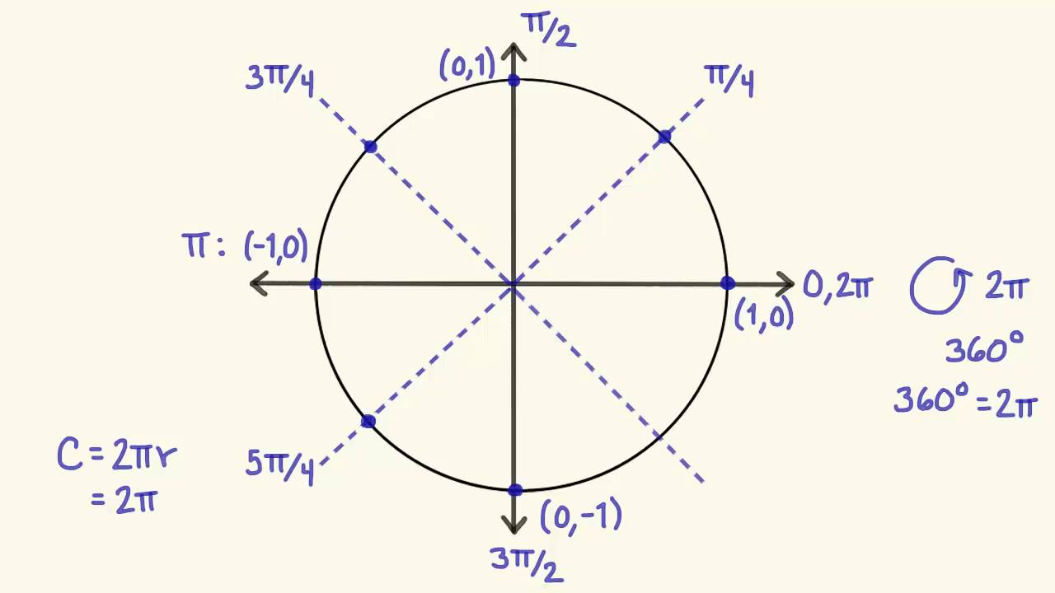
Conversión de grados a radianes
$y=\frac{x°∙2π}{360°}=\frac{x°∙π}{180°}rad$
$y=\frac{56.30°∙π}{180°}rad=0.9827rad$
$$θ$$
$$x°=y rad$$

Slide 7
El plano complejo
$$r=\sqrt{{(−5)}^{2}+{(3)}^{2}}=\sqrt{25+9}=\sqrt{34}$$
$$θ=\arctan\left(\frac{b}{a}\right)$$
-$5+3i$
$$θ=\arctan\left(\frac{3}{−5}\right)=−30.96°$$
$$149.03°$$
$$\sqrt{34}$$
$$α=180−abs\left(θ\right)=180−30.96=149.03°$$
$$5$$
$$θ$$

Slide 8
El plano complejo
$$r=\sqrt{{(a)}^{2}+{(b)}^{2}}=$$
$θ=90° si a=0 ,y>0$
3$0°=\frac{π}{6}$
$90°=\frac{π}{2}$
$θ=270° si a=0 ,y<0$
6$0°=\frac{π}{3}$
13$5°=\frac{3π}{4}$
$45°=\frac{π}{4}$
$$π$$
$0$
$$2π$$
$270°=\frac{3π}{2}$

Slide 9
Suma
$$3+ 2i$$
$$2+5i$$
----------
$$5+7i$$
$$−5+3i$$
$$4−i$$
------------
$$−1+2i$$
$$+$$
$$+$$

Slide 10
Resta
$$3+ 2i$$
$$2+5i$$
----------
$$1−3i$$
$$−5+3i$$
$$4−i$$
------------
$$−9+4i$$
$$−$$
$$3+2i −\left(2+5i\right)=3+2i−2−5i=1−3i$$
$$−$$
$$−5+3i−\left(4−i\right)=−5+3i−4+i=−9+4i$$

Slide 11
Multiplicación
$$3+ 2i$$
$$2+5i$$
----------
$$6+15i+4i+10i^{2}=6+19i−10=−4+19i$$
$$−5+3i$$
$$4−i$$
------------
$$−20+5i+12i−3i^{2}=−20+17i+3=−17+17i$$
$$x$$
$$x$$

Slide 12
División
$$\frac{3+ 2i}{2+5i }$$
Multiplicar por el conjugado del denominador $(2−5i)$
$$\frac{3+ 2i}{2+5i }∗\frac{2−5i}{2−5i}=\frac{6−15i+4i−10i^{2}}{2^{2}+5^{2}}=\frac{6−15i+4i+10}{4+25}$$
$$\frac{16−11i}{29}=\frac{16}{29}−\frac{11}{29}i$$
-1

Slide 13
$20∗CiS 113°$
$x=20∙\cos\left(113°\right)=20∗\left(−0.3907\right)=−7.8146$
$y=20∙\sin\left(113°\right)=20∗0.9205=18.41$
$$113°$$

Slide 14
1
360 498
138

